Slide 1

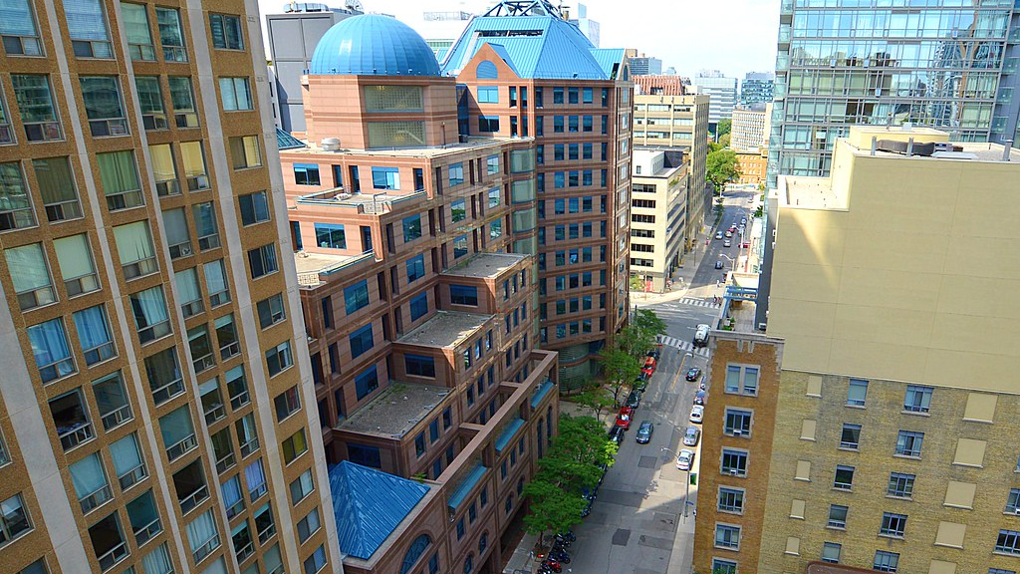


Group 19
School Dropout Prevention vs. Social Housing Investment: Where to Channel Resources for Mitigating Gun Crime in Toronto?
By: Jonathan Coutu Runmeng Qin Yuxing Zhang
Yuchen Zhang Mingcheng xu Shaokun Zhang
The work we submitted as part of this assignment is original, and due credit is given to others where appropriate. We accept and acknowledge that that each member of our team is equally responsible for if the assignment found to be plagiarized in any way, and we will be subject to school’s Academic Integrity policy

Slide 2

INTRODUCTION & OBJECTIVES
OBJECTIVE
The aim of this analysis is to identify the types of public interventions that could yield the most significant impact on reducing firearm-related crimes. Our analysis sought to discern the relative influence of neighborhood dropout rates compared to housing affordability, with the aim of determining the appropriate allocation of public funds—whether to prioritize high school diploma achievement or to enhance access to social housing interventions
KEY QUESTIONS
Can government intervention in social housing effectively contribute to the reduction of firearm-related crime?
Could a substantial investment in dropout prevention yield a beneficial impact in mitigating firearm-related crime?
Introduction Basic Analysis Modeling Analysis Conclusion
Group 19

Slide 3

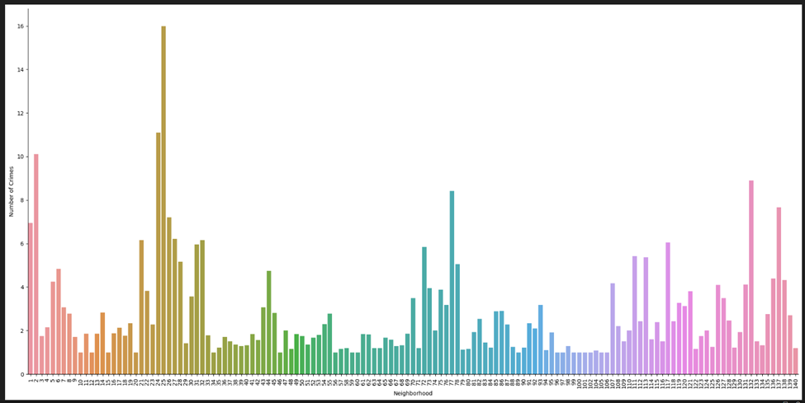
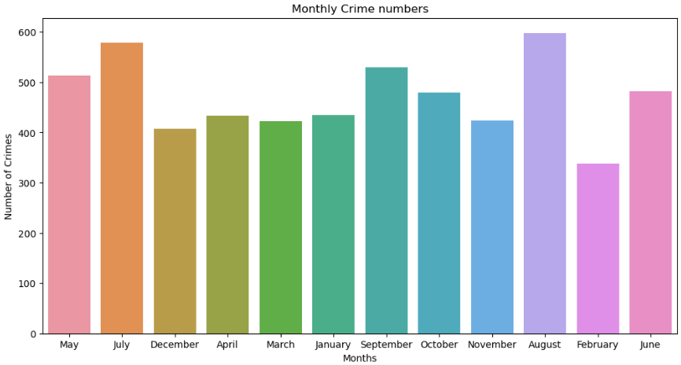
BASIC ANALYSIS & TRENDS AND PATTERNS
Total Neighborhood Crime
Neighborhood Characteristics
Data Seasonality
Introduction Basic Analysis Modeling Analysis Conclusion
Group 19
Notes:
第一个图是不同neb的犯罪数量，每个月的犯罪事件

Slide 4


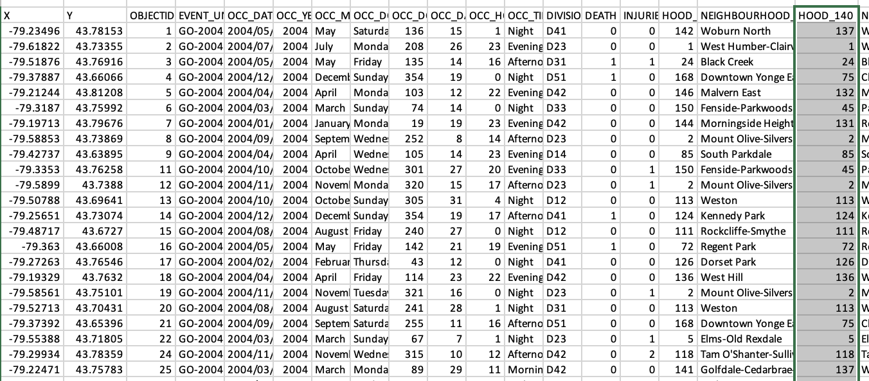
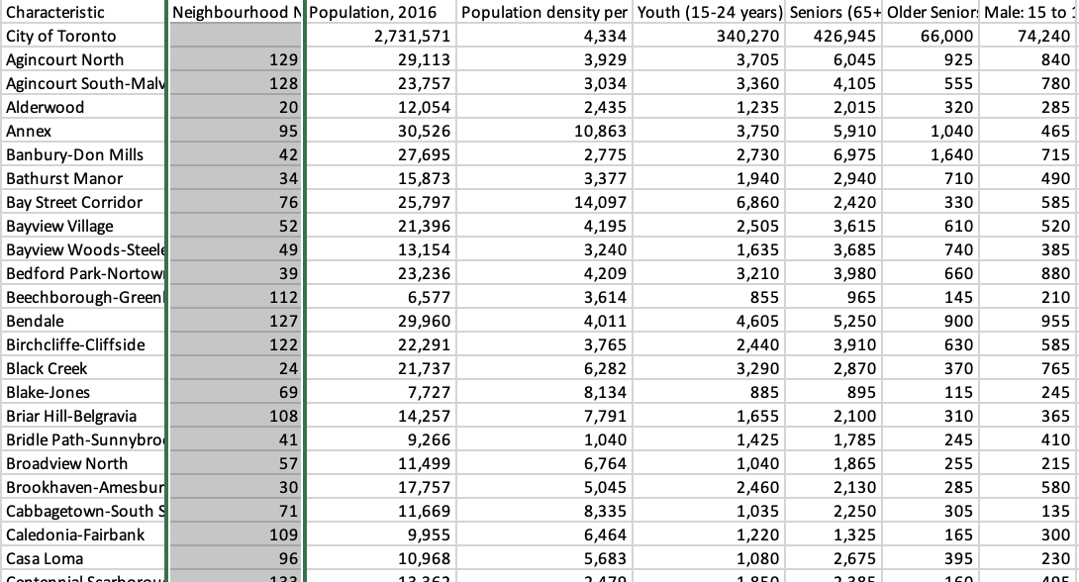
EXTERNAL DATA
City of Toronto Neighbourhood Profiles use this Census data to provide a portrait of the demographic, social and economic characteristics of the people and households in each City of Toronto 140 neighbourhoods
TPS Crime Statistics - Shootings & Firearm Discharges
City of Toronto Neighborhood Profiles 2016
*Both tables were joined in Excel using the function lookup, the 140 neighborhood ID being the common key.

Slide 5
Modeling & FEATURE ENGINEERING
Monthly Grouping
Neighborhood Grouping
$Target Variable= \frac{Total Number of Gun Events}{Population}$ x 1000
Introduction Basic Analysis Modeling Analysis Conclusion
Group 19

Slide 6
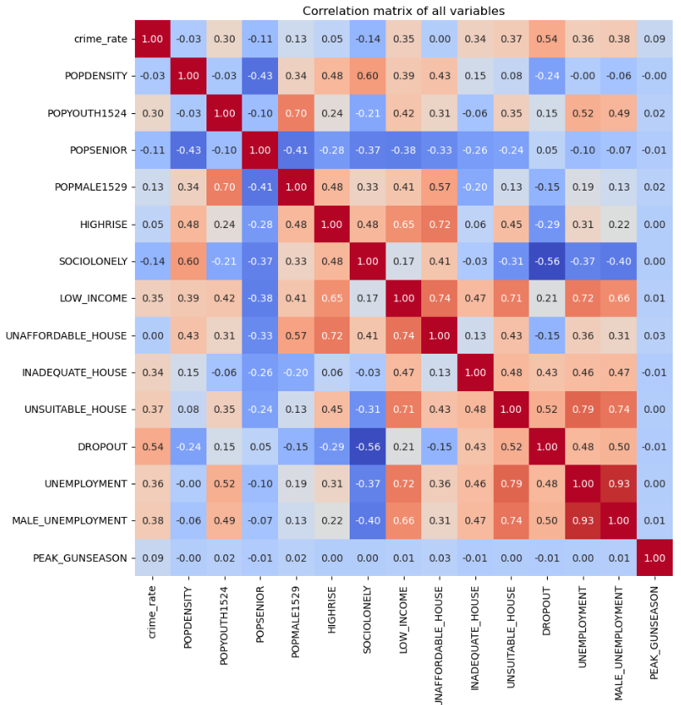
Modeling & CORRELATION MATRIX
Exclusion for Multicollinearity
The OLS model is susceptible to multicollinearity, necessitating manual variable elimination:
Strong correlation (0.70) between POPYOUTH1524 and POPMALE1529 --> Pick feature POPYOUTH1524
Strong correlation (0.93) between UNEMPLOYMENT and MALE_UNEMPLOYMENT --> Pick feature UNEMPLOYMENT
Strong correlation (0.79) between UNEMPLOYMENT and UNSUITABLE_HOUSE --> Pick UNEMPLOYMENT
Strong correlation (0.72) between UNAFFORDABLE_HOUSE and HIGHRISE --> Pick UNAFFORDABLE_HOUSE
Introduction Basic Analysis Modeling Analysis Conclusion
Group 19

Slide 7
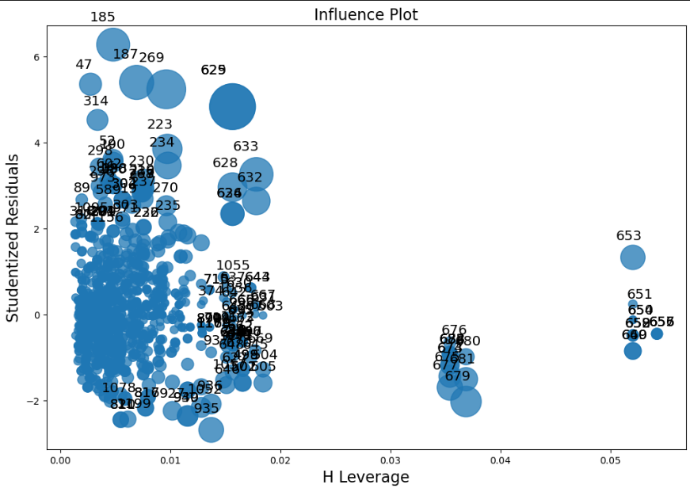
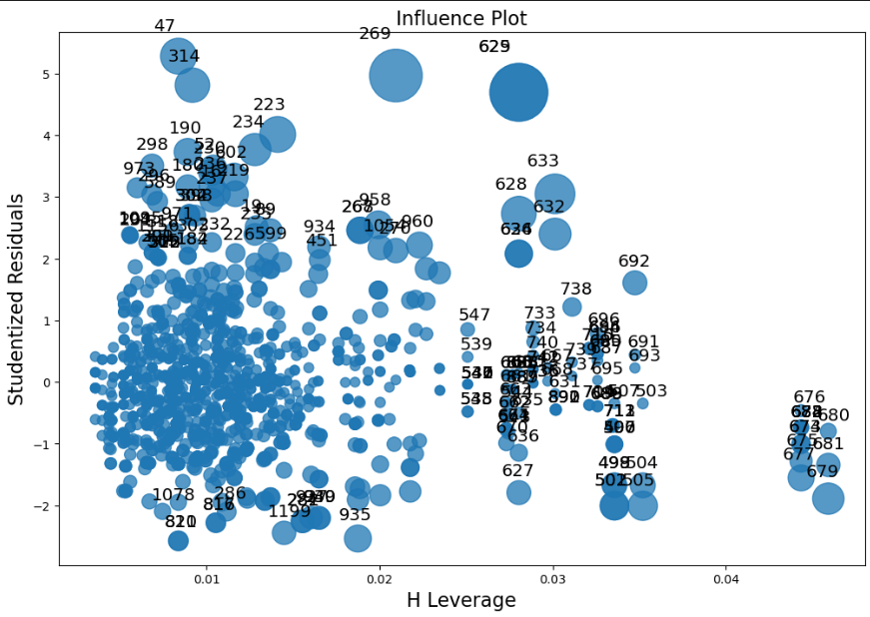
Modeling & OLS
The Ordinary Least Squares (OLS) model can be good choice because we place a higher emphasis on achieving interpretability rather than focusing solely on predictability.
OLS model is sensitive to outliers so 15 data have been dropped.
Outlier Exclusion
Before dropping
After dropping
Introduction Basic Analysis Modeling Analysis Conclusion
Group 19

Slide 8

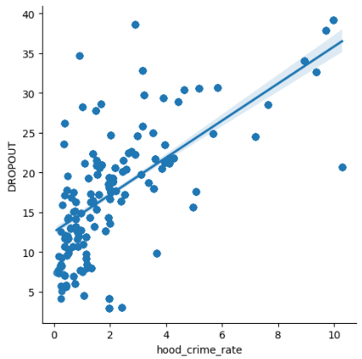
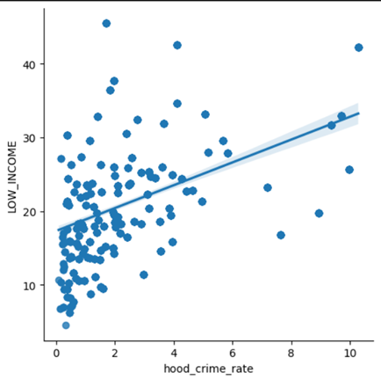
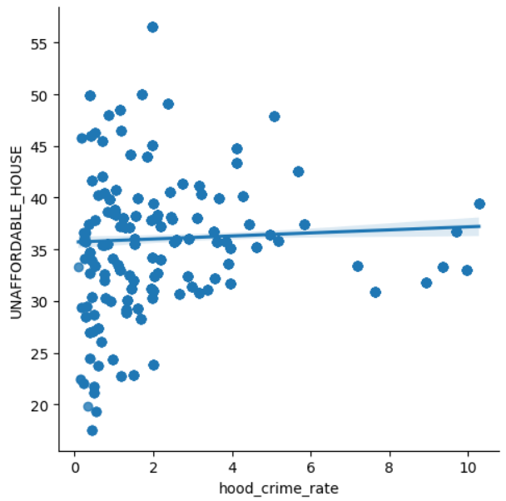
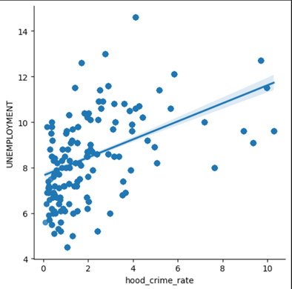
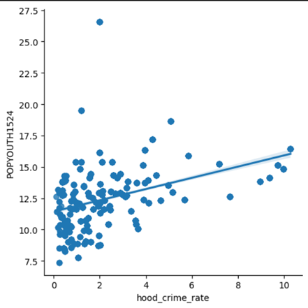
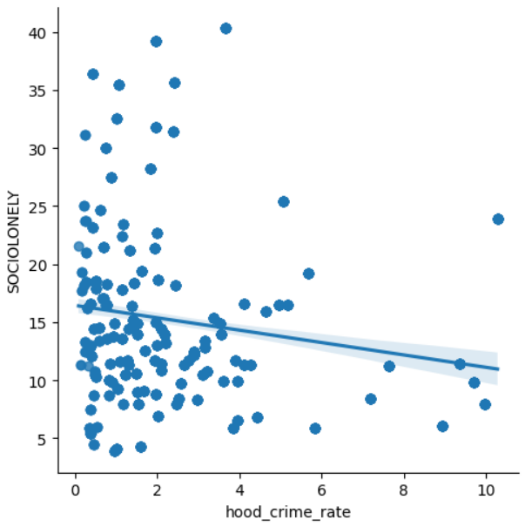
≈
BASIC ANALYSIS & TRENDS AND PATTERNS
Dropout VS Crime Rate
Low Income VS Crime Rate
Unaffordable House VS Crime Rate
This plot shows that higher dropout rate will lead to higher crime rate.
The Higher low income rate will lead to higher crime rate.
The correlation between unaffordable house and crime rate is not strong.
Unemployment VS Crime Rate
Popyouth1542 VS Crime Rate
Sociolonely VS Crime Rate
The higher unemployment rate will lead to higher crime rate, positive correlation.
The higher population of youth (age 15-24) rate will lead to higher crime rate, positive correlation.
The lower person living alone rate will lead to higher crime rate, negative correlation.
Introduction Basic Analysis Modeling Analysis Conclusion
Group 19

Slide 9

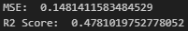
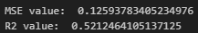
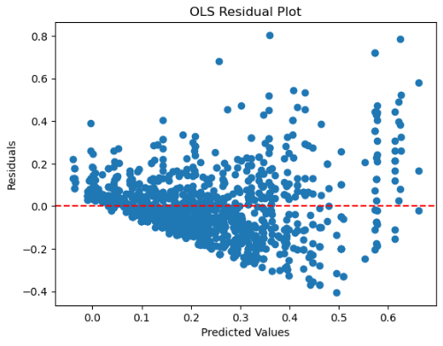
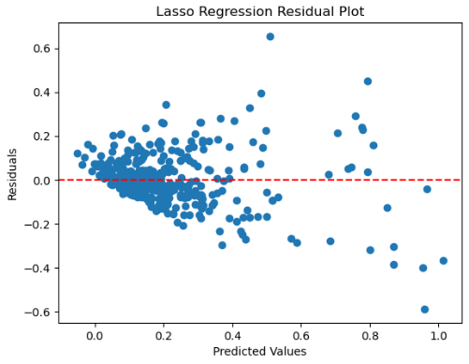
POST-MODELING ANALYSIS & EVALUATION METRICS
OLS
LASSO
MSE & R-SQUARED
VISUALISATION OF ERRORS
Based on the comparison of the two models, we can conclude that LASSO performs better in prediction. This matches our expectation because LASSO can better handle the multicollinearity issue. However, we don’t want to sacrifice the power of variable explanation that OLS provides, so we will use both models for our study. We will use LASSO to study impacts, and OLS to study explanatory variables.
Introduction Basic Analysis Modeling Analysis Conclusion
Group 19
Notes:
We will go for OLS since it has higher explanation power, even though LASSO will give more accruate predicton.

Slide 10
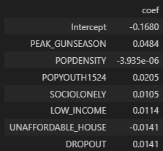
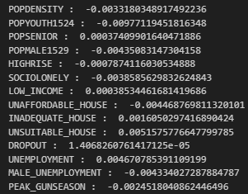
POST-MODELING ANALYSIS & EXPLANATORY VARIABLE OLS VS LASSO
OLS Features
LASSO Features
OLS to explain the relationship between the features and crime rate, even though it may not predict the crime rate as accurately as LASSO does.
However, LASSO's good prediction performance (better MSE and R2 value) also indicates that it indeed has advantages in handling multicollinearity when there are many available features.
Introduction Basic Analysis Modeling Analysis Conclusion
Group 19

Slide 11
POST-MODELING ANALYSIS & EXPLANATORY VARIABLE IN OLS
PEAK_GUNSEASON: Peak-gun-season represents the months with the most firearm crimes. The coefficient indicates that this is a significant driver of the crime rate, and reducing the number of crimes during the peak season will significantly decrease the overall crime rate.
POPDENSITY: Population density describes the concentration of the population. The coefficient is relatively low, indicating that it is not a major influencer of the crime rate.
POPYOUTH1524: This variable represents the total number of youth aged between 15 to 24 years old in a neighborhood. The coefficient is 0.0205, suggesting that communities with a higher number of youths tend to have a higher crime rate.
SOCIOLONELY: This variable measures the percentage of people living alone. The positive coefficient potentially indicates that people feeling "alone" in a community may lead to a higher crime rate.
LOW_INCOME: is the percentage of people in private households in low income status according to the Low Income Cut-Off, After-Tax. The positive coefficient makes sense since a higher proportion of poor people in a community may potentially lead to a higher crime rate.
UNAFFORTABLE_HOUSE: This is the percentage of private households in the neighborhood spending more than 30 per cent of their total household income on shelter costs.
DROPOUT: This variable represents the percentage of people without a high school diploma. The positive coefficient indicates that communities with higher educational attainment tend to have a lower crime rate. This education milestone achievement is a strong predictor gun crime rate.
Introduction Basic Analysis Modeling Analysis Conclusion
Group 19

Slide 12
CONCLUTION & RECOMMENDATION
Seasonality emerged as a prominent factor, with a heightened occurrence of gun events from July to September
Demographic variables also played a notable role, particularly the proportion of youth aged between 15 to 24
Geographic factors incorporated both the neighborhood's identity and population density per square kilometer, providing spatial understanding
Socio-economic considerations like poverty and isolation rates within neighborhoods also influence gun violence
High school dropout rate VS unaffordable housing rate
Neighborhoods with elevated dropout rates typically witness higher levels of gun violence, highlighting the importance of education-focused investments as a preventive measure
Unaffordable housing did not correlate positively with increased gun violence as one might expect.
This surprising outcome necessitates further inquiry to understand the complex interplay between housing affordability and gun violence. This study has illuminated several key aspects of the multifaceted issue of gun violence, yet, the complexity of the problem and the surprising outcomes noted, especially concerning housing unaffordability, call for continued research and nuanced understanding.
11
Introduction Basic Analysis Modeling Analysis Conclusion
Group 19

Slide 13
CONCLUTION & KEY QUESTIONS
Can government intervention in social housing effectively contribute to the reduction of firearm-related crime?
Our study appears to suggest that investments in social housing may not yield the anticipated effects in reducing firearm-related crime. The negative coefficient sign on the 'unaffordable house rate' variable is perplexing. We hypothesize that many individuals and families are willing to allocate a larger proportion of their income in exchange for a safer environment. This unexpected result calls for further research to fully understand the implications of housing affordability on firearm-related crime rates.
Could a substantial investment in dropout prevention yield a beneficial impact in mitigating firearm-related crime?
Our analysis demonstrates that the high school dropout rate is a powerful explanatory variable for the gun crime rate across the 140 neighborhoods of Toronto. This suggests that an investment geared towards preventing school dropout could potentially have a tangible impact on reducing firearm-related violence in Toronto.
12
Introduction Basic Analysis Modeling Analysis Conclusion
Group 19

Slide 14
https://www.planetde/59730
Reference
National Criminal Justice Reference Service. (n.d.). Unemployment and Crime. Retrieved from https://www.ojp.gov/ncjrs/virtual-library/abstracts/unemployment-and-crime-1#:~:text=The%20studies%20indicate%20that%20crime,a%20powerful%20determinant%20of%20crime
Planetizen. (n.d.). What Role Does Density Play in Gun Violence? Retrieved from https://www.planetizen.com/node/59730
2016 neighbourhood profile neighbourhood # annex - city of Toronto. (n.d.). https://www.toronto.ca/ext/sdfa/Neighbourhood%20Profiles/pdf/2016/pdf1/cpa95.pdf

Slide 15

https://www.planetde/59730

Slide 16

APPENDIX

Slide 17
EXTERNAL DATA
The Census of Population is held across Canada every 5 years and collects data about age and sex, families and households, language, immigration and internal migration, ethnocultural diversity, Aboriginal peoples, housing, education, income, and labour. City of Toronto Neighbourhood Profiles use this Census data to provide a portrait of the demographic, social and economic characteristics of the people and households in each City of Toronto neighbourhood. The profiles present selected highlights from the data, but these accompanying data files provide the full data set assembled for each neighbourhood.
In these profiles, "neighbourhood" refers to the City of Toronto's 140 social planning neighbourhoods. These social planning neighbourhoods were developed by the City of Toronto to help government and community organizations with local planning by providing socio-economic data at a meaningful geographic area. The boundaries of these social planning neighbourhoods are consistent over time, allowing for comparison between Census years. Neighbourhood level data from a variety of other sources are also available through the City's Wellbeing Toronto mapping application and here on the Open Data portal.
Each data point in this file is presented for the City's 140 neighbourhoods, as well as for the City of Toronto as a whole. The data is sourced from a number of Census tables released by Statistics Canada. The general Census Profile is the main source table for this data, but other Census tables have also been used to provide additional information.
Source: https://open.toronto.ca/dataset/neighbourhood-profiles/

Slide 18
POST-MODELING ANALYSIS & EXPLANATORY VARIABLE IN LASSO
POPDENSITY(Population density, the number of people per unit area): The coefficient is about -0.0033. The negative coefficient indicates that when population density increases 1%, the crime rate decreases 0.0033%.
POPYOUTH1524(Proportion of young people aged 15 to 24): The coefficient is approximately -0.0098. The negative coefficient indicates that when the percentage of the population aged 15 to 24 increases 1%, the crime rate decreases 0.0098%. This may be related to the fact that more educational and social programs are available in these areas, resulting in lower crime rates.
POPSENIOR(Proportion of elderly population aged 65 and over): The coefficient is approximately 0.0004. However, the coefficient value is very small, indicating that the relationship is weak.
POPMALE1529(Proportion of people aged 15 to 29): The coefficient is approximately -0.0044. The negative coefficient indicates that when the proportion of the male population between the ages of 15 and 29 increases 1%, there will be a slight decrease in the crime rate(0.0044%).
HIGHRISE: The coefficient is approximately -0.0008. The negative coefficient means that areas with more high-rise buildings are likely to have lower crime rates but the relationship is very weak.
SOCIOLONELY(Proportion of population socially isolated): The coefficient is about -0.0039. The negative coefficient means that crime rates decrease 0.0039% when the percentage of socially isolated population increases 1%.
LOW_INCOME(Proportion of population with low incomes): The coefficient is approximately 0.0004.The increase may not have a significant effect on crime rates, with such small coefficient.
UNAFFORDABLE_HOUSE(Percentage of unaffordable housing): The coefficient is approximately -0.0045. This negative coefficient means that crime rates decrease 0.0045% when the proportion of unaffordable housing increases 1%. Areas with more affordable housing may offer better living conditions and stability, resulting in lower crime rates.

Slide 19
POST-MODELING ANALYSIS & EXPLANATORY VARIABLE IN LASSO CONTINUE
INADEQUATE_HOUSE(proportions of inadequate houses): the coefficient is about 0.0016. this positive coefficient means that crime rates may increase slightly(0.0016%) when the proportion of unsuitable housing increases 1%. Poor housing conditions can lead to social instability and economic problems, which can lead to an increase in crime.
UNSUITABLE_HOUSE(proportions of Unsuitable house): The coefficient is approximately 0.0052. This positive coefficient means that crime rates can increase about 0.0052% when the proportion of unsuitable housing increases 1%. Unsuitable housing conditions may be associated with social problems that lead to an increase in crime rates.
DROPOUT(Dropout rate): The coefficient is approximately 0.000014 which may not have a significant effect on crime rates since the coefficient is too small.
UNEMPLOYMENT(Unemployment rate): The coefficient is approximately 0.0047. This positive coefficient indicates that crime will increase0.0047% when unemployment increases 1%. The economic problems associated with unemployment may lead to an increase in crime.
MALE_UNEMPLOYMENT(Male Unemployment Rate): the coefficient is approximately -0.0043. For every 1% increase in the male unemployment rate, the crime rate may decrease by 0.004%.
PEAK_GUNSEASON: The coefficient is approximately -0.0025. The negative coefficient means that crime may decrease slightly during the high gun season.

Slide 20
CORRELATION BETWEEN INTERESTED VARIABLE AND CRIME RATE
The correlation coefficient between DROPOUT and crime_rate is 0.536922, which is also a relatively high positive correlation coefficient. This suggests that when DROPOUT (dropout rate) increases, there is a higher likelihood that crime_rate (crime rate per 1,000) will also increase. This may reflect the fact that areas with higher dropout rates may be more prone to social problems, which can lead to increased crime rates.
The correlation coefficient between UNSUITABLE_HOUSE and crime_rate is 0.374328, which is also a positive correlation coefficient. This may indicate that areas with poorer quality housing may be more prone to social problems, leading to an increase in crime rates.
The correlation coefficients between UNEMPLOYMENT and MALE_UNEMPLOYMENT and CRIME_RATE are 0.362005 and 0.381498, respectively, which suggests that there is some degree of positive correlation between unemployment and male unemployment rates and crime rates. Areas with high unemployment rates may be more prone to social problems which may lead to increased crime rates.
The correlation coefficient between LOW_INCOME and crime_rate is 0.347249 which is also a positive correlation coefficient. This suggests that low income areas may be more prone to social problems which may lead to an increase in crime rate.
The correlation coefficient between INADEQUATE_HOUSE and crime_rate is 0.337249, which is also a positive correlation coefficient. This may indicate that areas with unsuitable housing may be more prone to social problems which may lead to an increase in crime rates.
The correlation coefficient between POPYOUTH1524 and crime_rate is 0.303297 which is a positive correlation coefficient. This may reflect the fact that an increase in the number of young people groups may lead to an increase in the crime rate.
The correlation coefficients between the other variables and crime_rate are small and close to 0, indicating a weak linear correlation between them.

Slide 21
INFLUENCE DIAGRAM
Before dropping
After dropping
*Drop influence points: 653, 651, 650, 654, 669, 657, 658, 652, 660, 187, 185, 649, 659, 656, 655

Slide 22
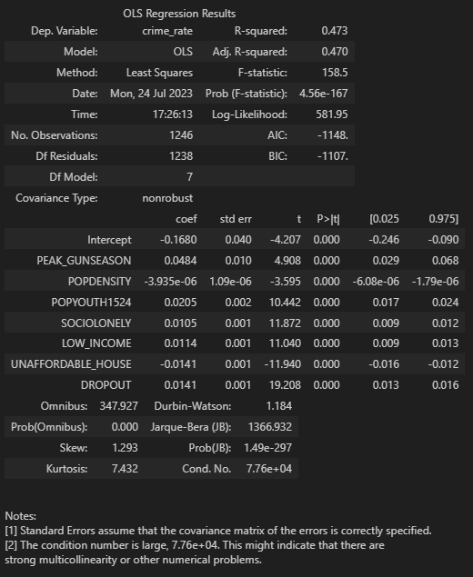
OLS SUMMARY TABLE

Slide 23
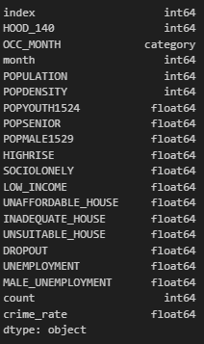
DATA CLEANING & PROCESSING
Data Cleaning
We extracted the month data from the OCC_DATE for grouping later.
We grouped our data by neighborhoods and months to study which community characteristics will affect the crime rate.
For the original dataset, we only kept three columns: OBJECTID, HOOD_140, and OCC_MONTH. We joined this with our external dataset.
The data from the external dataset contains percentage variables, which we will convert to floats for modeling purposes.

Slide 24
DATA DESCRIPTION

Slide 25
APPENDIX-CODING OVERVIEW

Slide 26
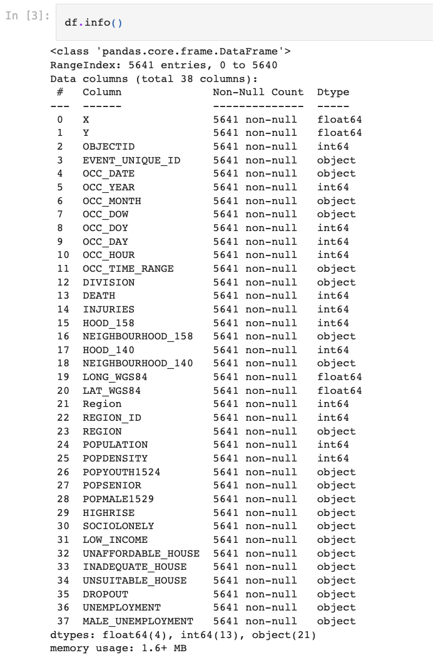
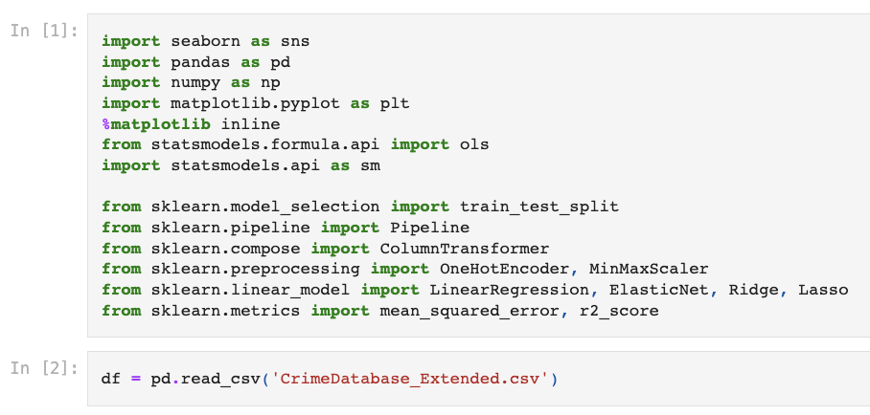
CLEANING & ENGINEERING

Slide 27
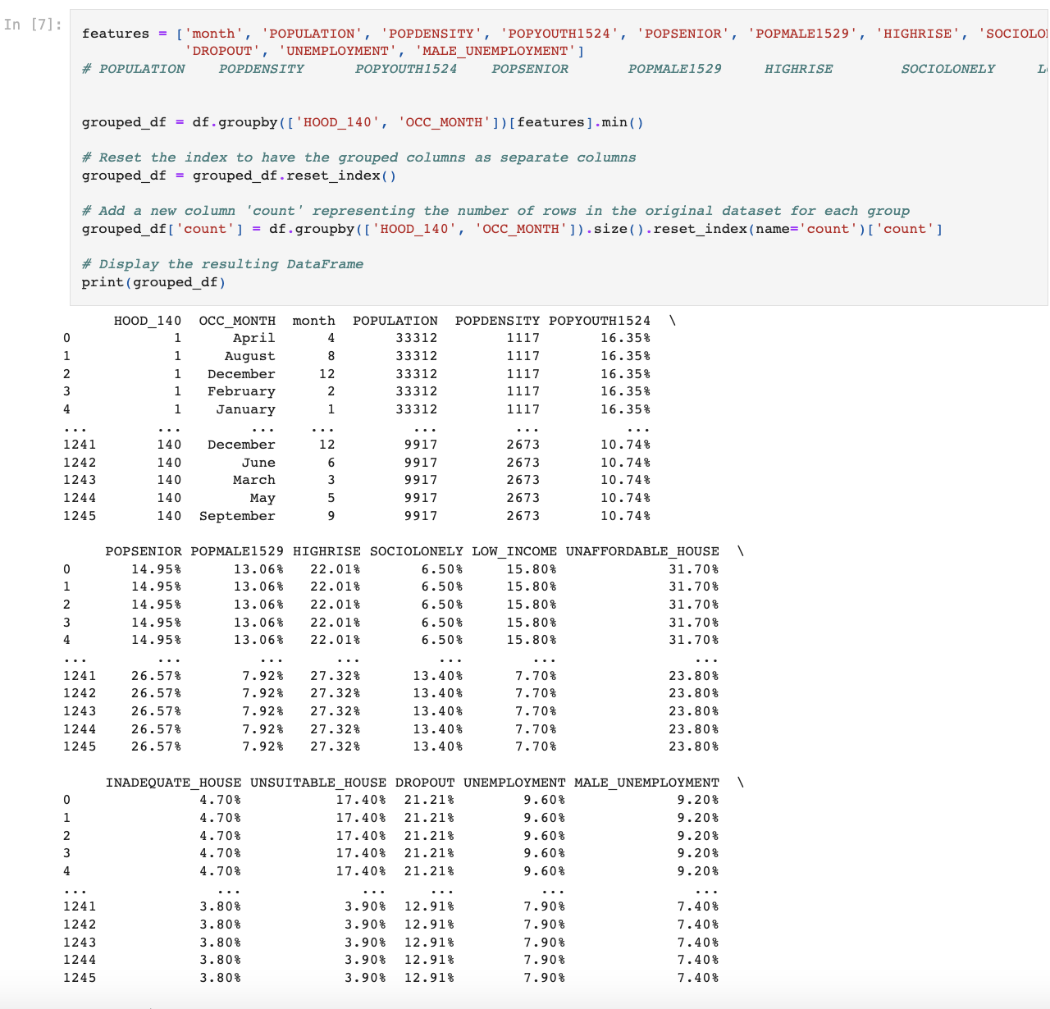
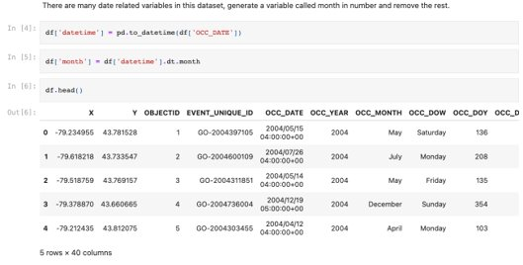
CLEANING & ENGINEERING

Slide 28
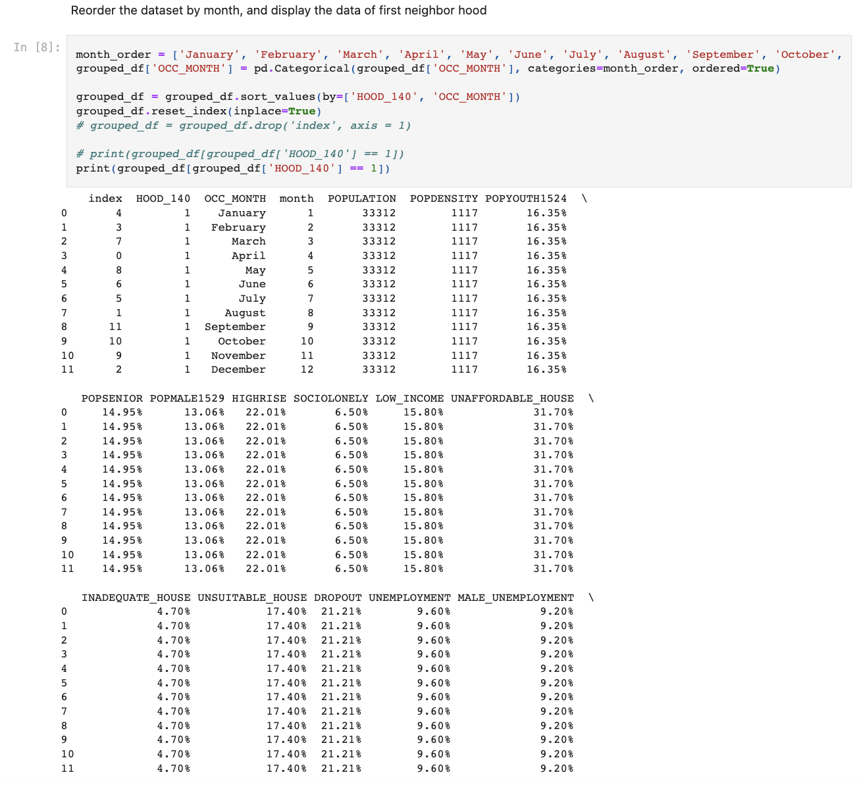
CLEANING & ENGINEERING

Slide 29
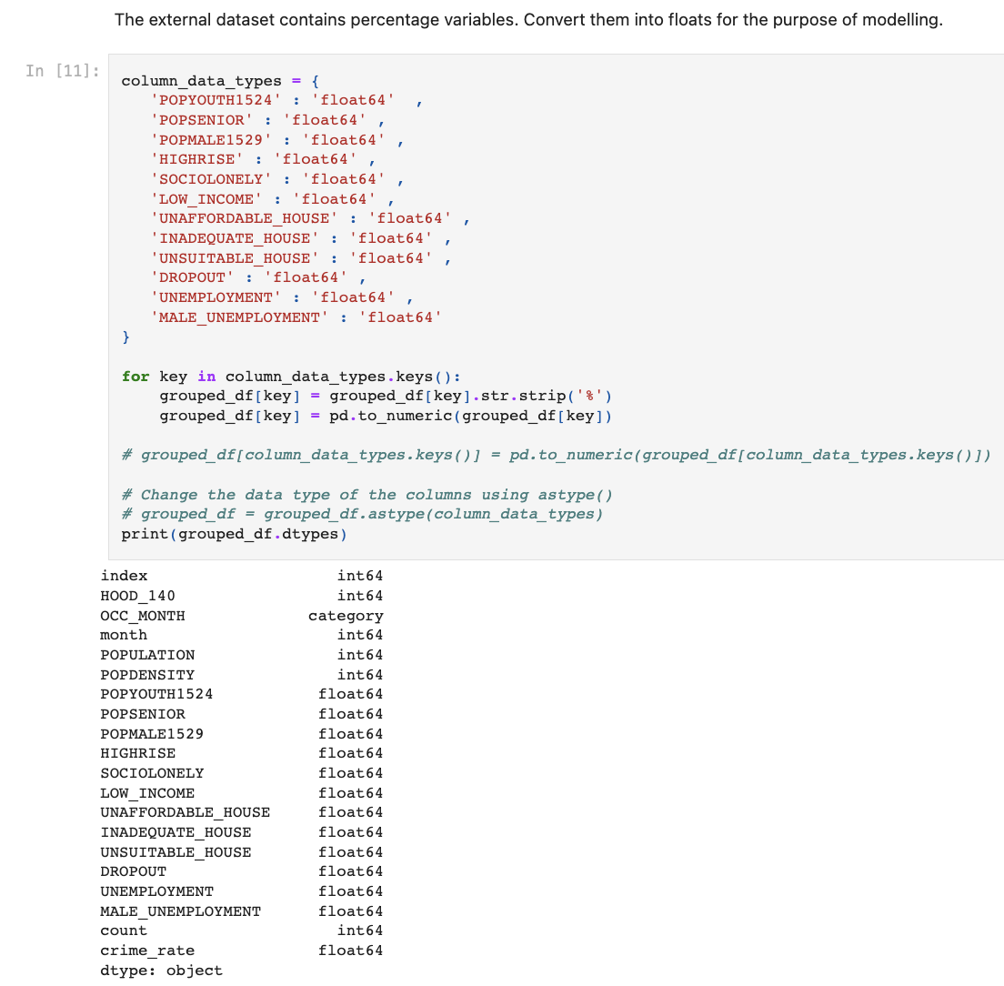
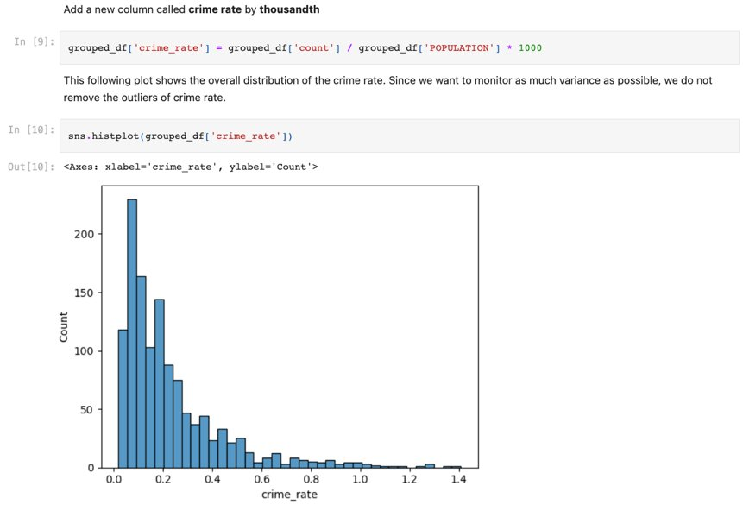
CLEANING & ENGINEERING

Slide 30
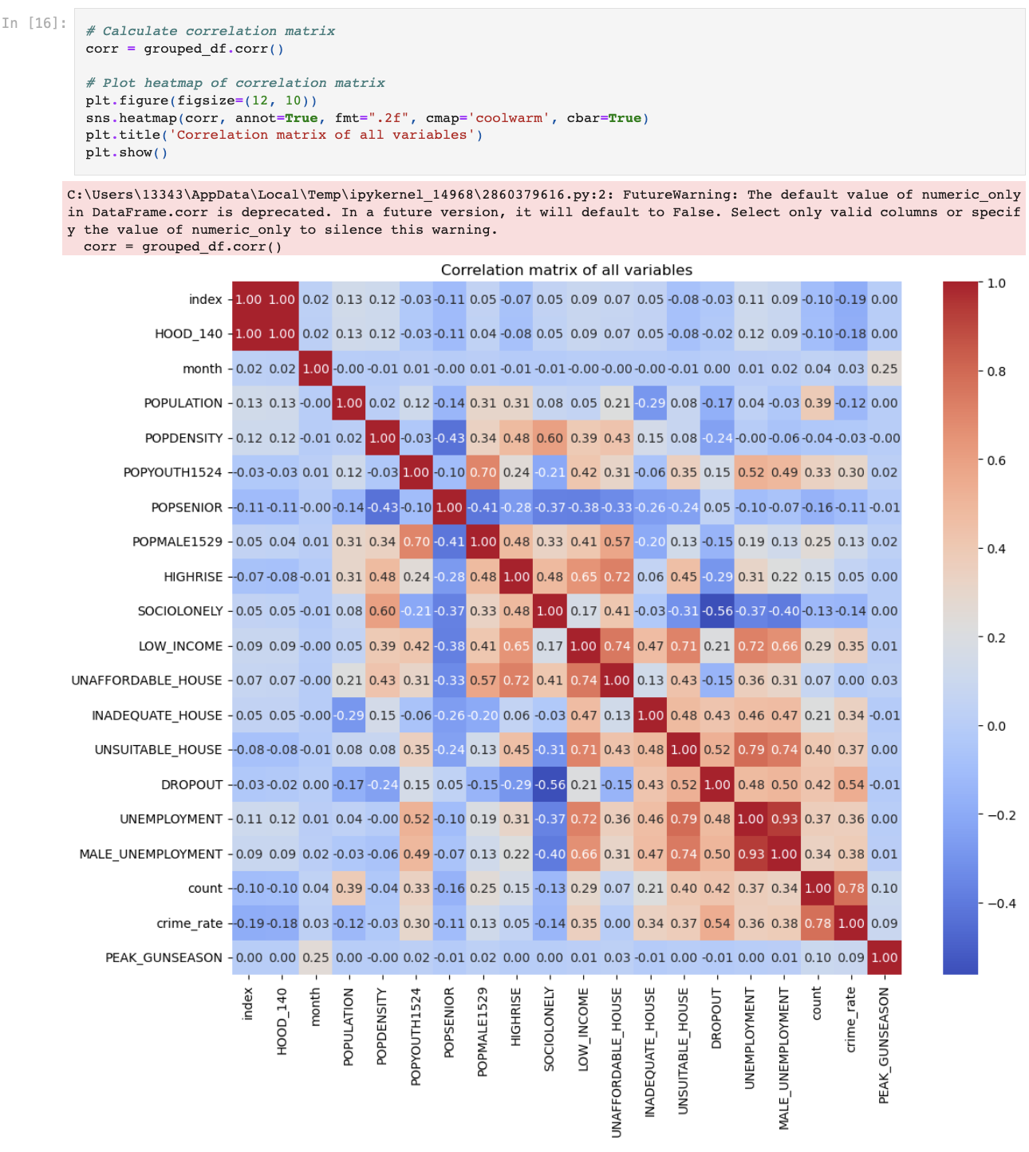
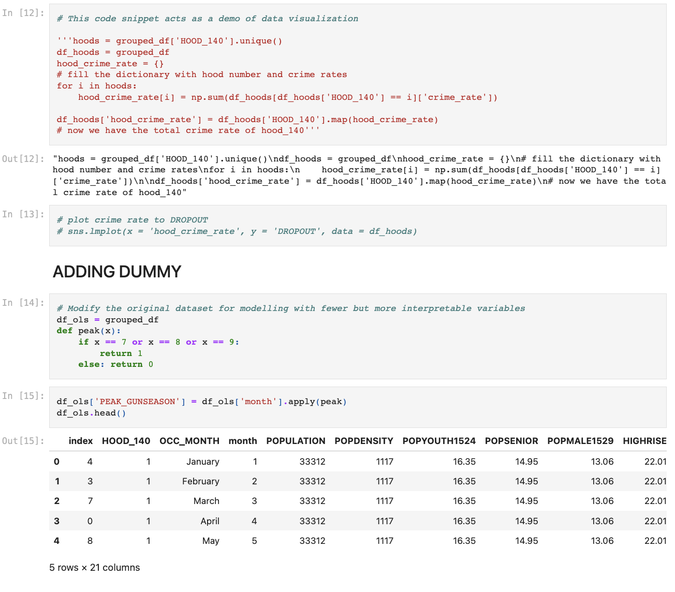
CLEANING & ENGINEERING

Slide 31
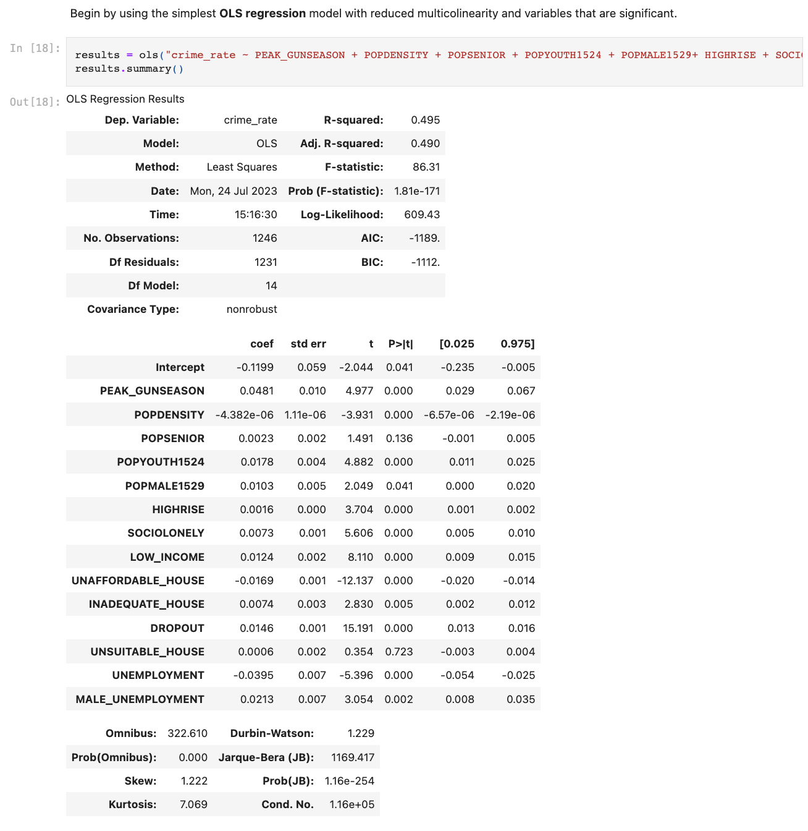
MODELLING

Slide 32
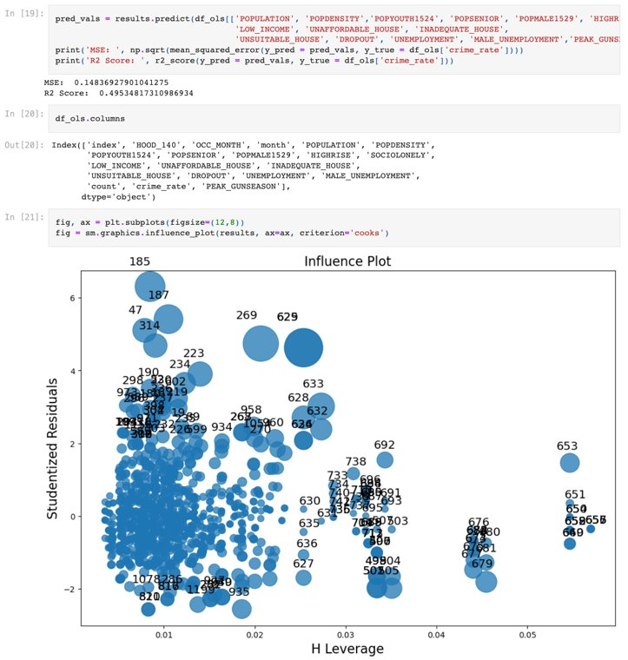
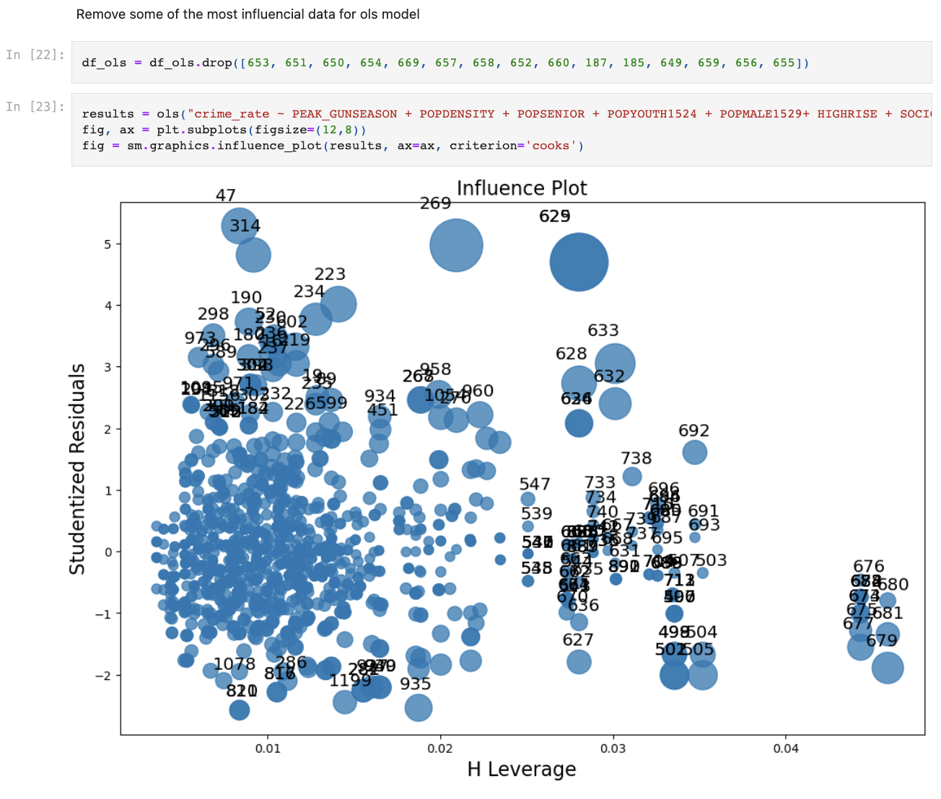
MODELLING

Slide 33
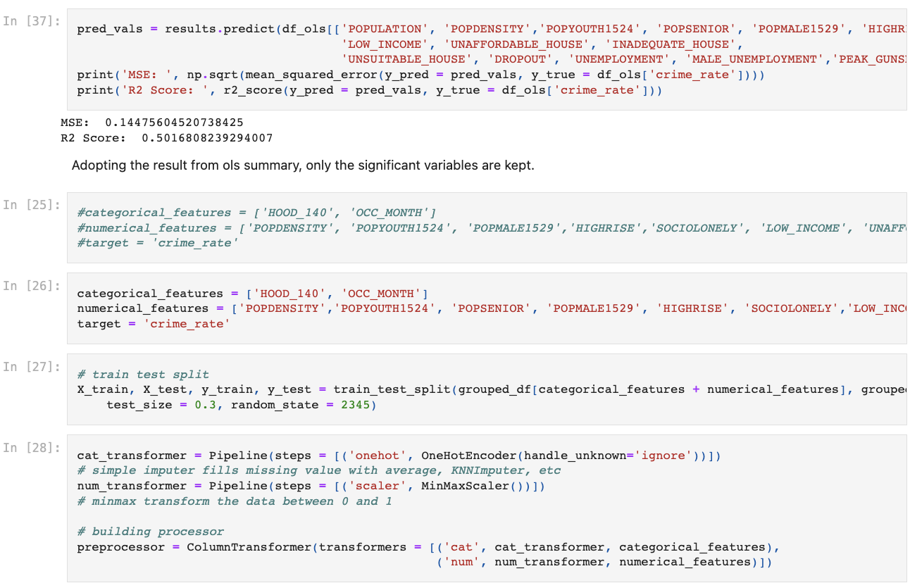
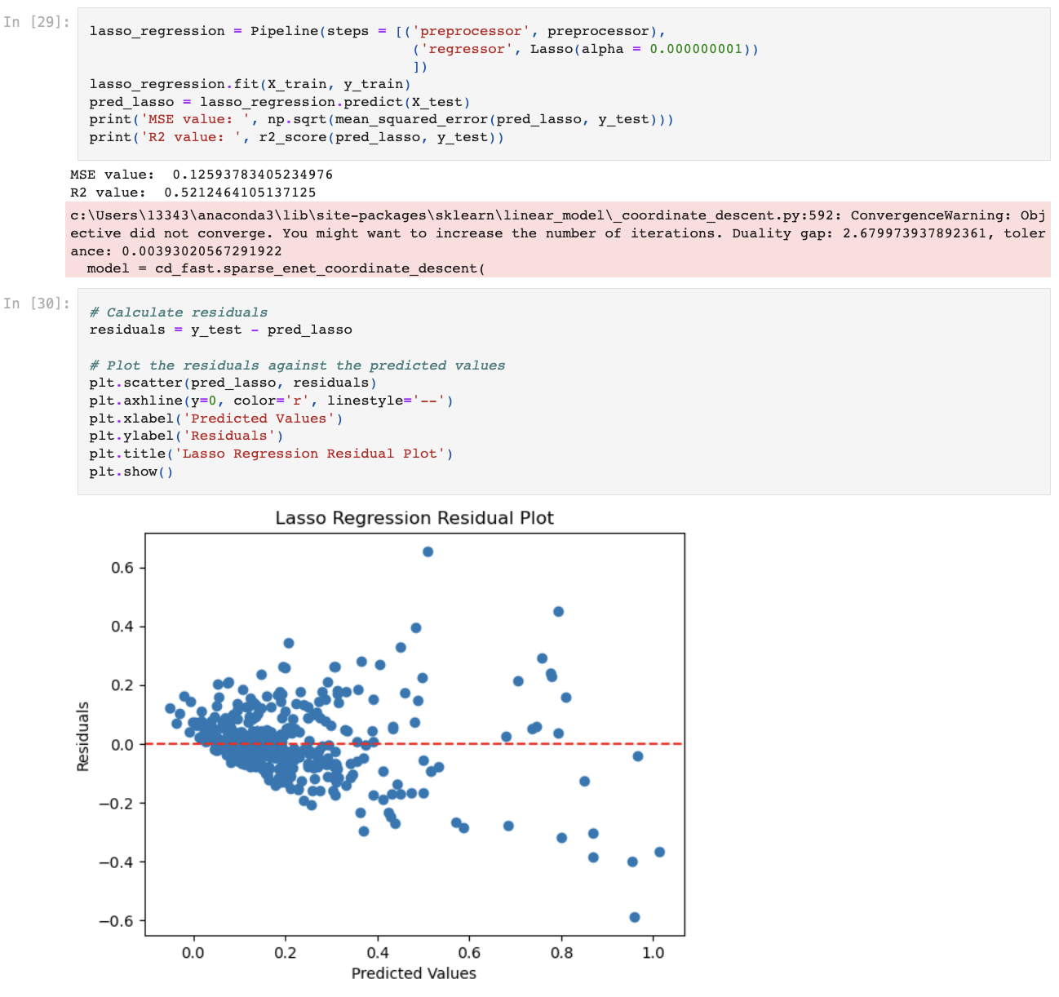
MODELLING

Slide 34
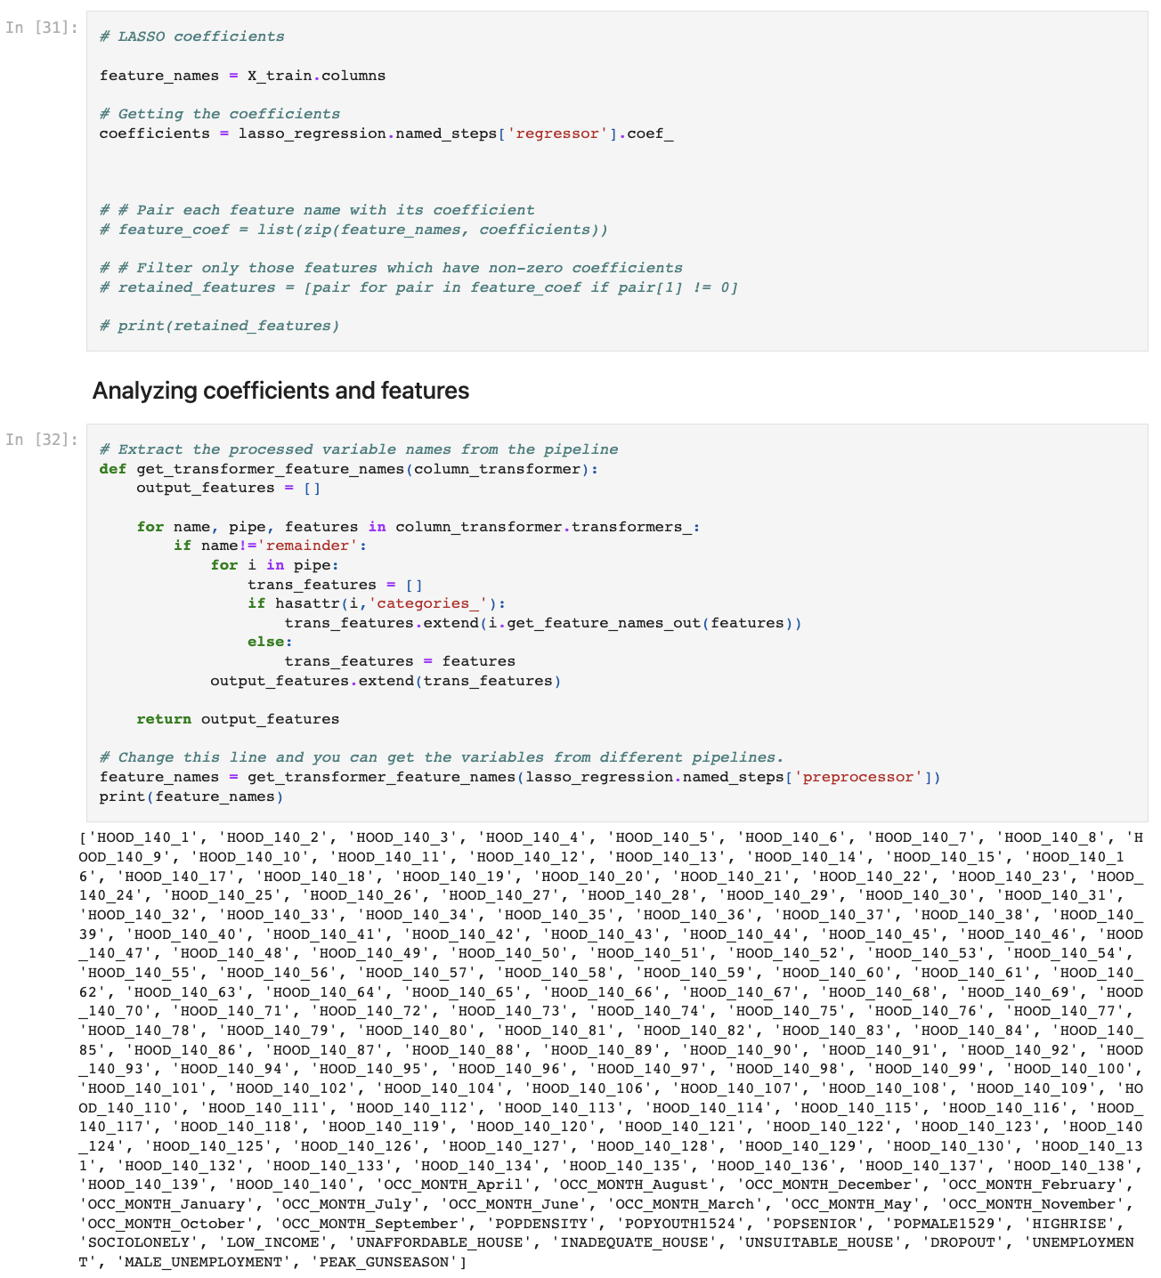
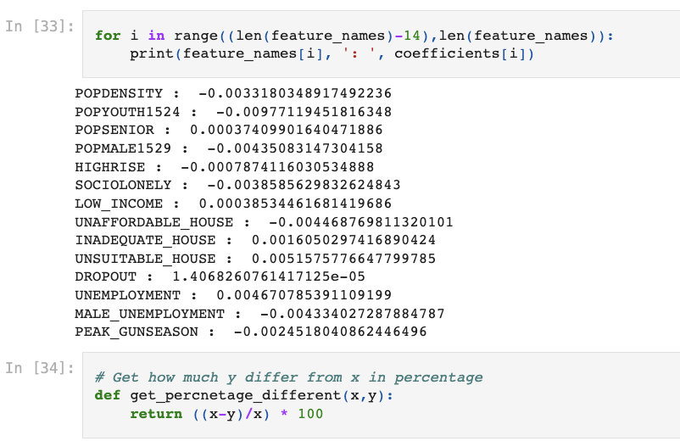
MODELLING

Slide 35







Agenda
EXECUTIVE SUMMARY
INTRODUCTION
BASIC ANALYSIS
MODELING
ANALYSIS
CONCLUSION

Slide 36
EXECUTIVE SUMMARY
This research sets out to discern which public intervention strategies - investment in education or financing social housing - can have the most pronounced effect on mitigating firearm-related criminal activities.
This research thoroughly investigates monthly gun events across Toronto's 140 neighborhoods using OLS and LASSO models, incorporating variables such as seasonality, demographics, geography, and socioeconomic factors.
The analysis shows that the period from July to September has a significantly higher rate of gun events, pointing towards a seasonal pattern in gun crime. Demographic factors were also influential, especially the proportion of youth aged 15-24 in the neighborhood. Geographic factors such as neighborhood and population density per square kilometer were also considered. From a socioeconomic perspective, local poverty levels and isolation rates were explored.
Two variables of particular interest were the high school dropout rate and the rate of unaffordable housing across Toronto's neighborhoods. Findings indicate that the high school dropout rate is a strong explanatory variable for the prevalence of gun crime. Contrary to our initial hypothesis, the rate of unaffordable housing pointed in the opposite direction.
Based on our analysis, it is suggested that investment should be directed more towards education rather than social housing funding to maximize gun violence reduction in Toronto. To our surprise, the unaffordability of housing showed a contrary correlation to gun violence, undermining the common perception that housing unaffordability is directly linked to higher crime rates. Further research is required to understand the nuances of this relationship. Nonetheless, our study strongly underlines the value of education as a preventive measure against gun violence.
Executive Summary Introduction Basic Analysis Modeling Analysis Conclusion
Group 19
1

